Slide 1


Quantum Cryptography: Securing Communication in the Quantum Era
Quantum cryptography utilizes the principles of quantum mechanics to enable secure communication in the digital age. By harnessing the unique properties of quantum particles, this cutting-edge technology safeguards sensitive information from even the most sophisticated cyber threats.
by Dwaraka Siva Sai Sri N

Slide 2
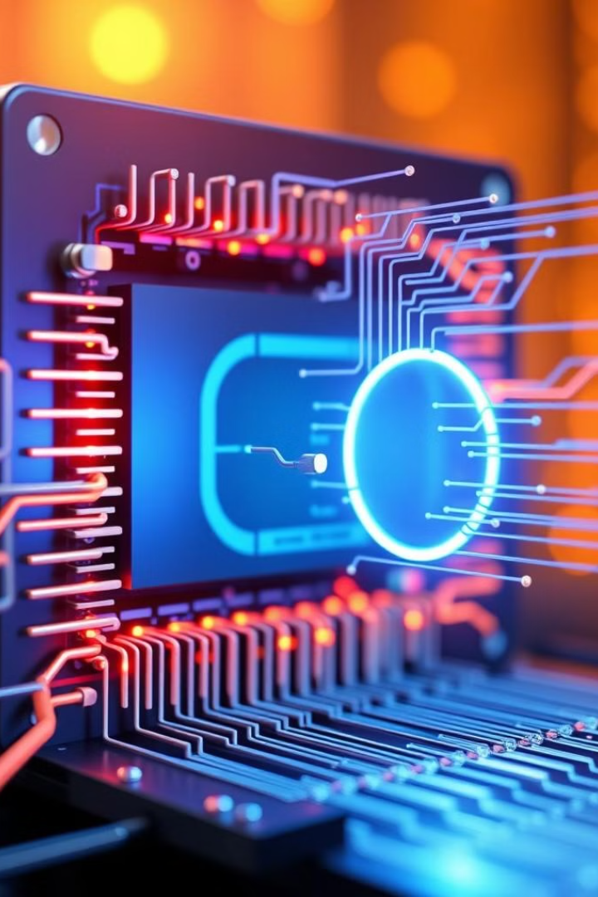
Quantum Bits (Qubits): The Building Blocks of Quantum Cryptography
1
Superposition
2
Entanglement
Unlike classical bits, qubits can exist in multiple states simultaneously, enabling exponentially more information to be encoded.
Qubits can become "entangled", allowing their properties to be linked, even over large distances.
3
Measurement
Observing a qubit causes it to collapse into a definite state, disrupting the delicate quantum system.

Slide 3
Superposition and Uncertainty: The Foundations of Quantum Mechanics
Superposition
Uncertainty Principle
Quantum Indeterminacy
Quantum particles can exist in multiple states simultaneously, challenging our classical understanding of reality.
The more precisely the position of a particle is determined, the less precisely its momentum can be known, and vice versa.
The outcome of a quantum measurement is inherently unpredictable, introducing fundamental randomness into the universe.

Slide 4

No-Cloning Theorem: Preventing Eavesdropping in Quantum Networks
Unique States
Measurement Disruption
Quantum states cannot be perfectly copied or cloned, preventing eavesdroppers from intercepting and duplicating the quantum signals.
Any attempt to measure or copy the quantum states will inevitably disturb the system, alerting the communicating parties to the presence of an eavesdropper.
Unbreakable Encryption
The no-cloning theorem ensures that quantum cryptography offers a level of security that is theoretically unbreakable, even by the most advanced classical computers.

Slide 5




Entanglement: Quantum Phenomena Enabling Secure Communication
Instantaneous Correlation
Entangled qubits exhibit instantaneous correlation, even when separated by large distances, enabling the transmission of information without a physical medium.
Eavesdropping Detection
Any attempt to measure or interact with the entangled qubits disrupts the delicate quantum state, alerting the communicating parties to the presence of an eavesdropper.
Cryptographic Key Generation
Entanglement can be used to generate a shared, secret cryptographic key that is immune to eavesdropping, forming the basis of quantum key distribution.

Slide 6
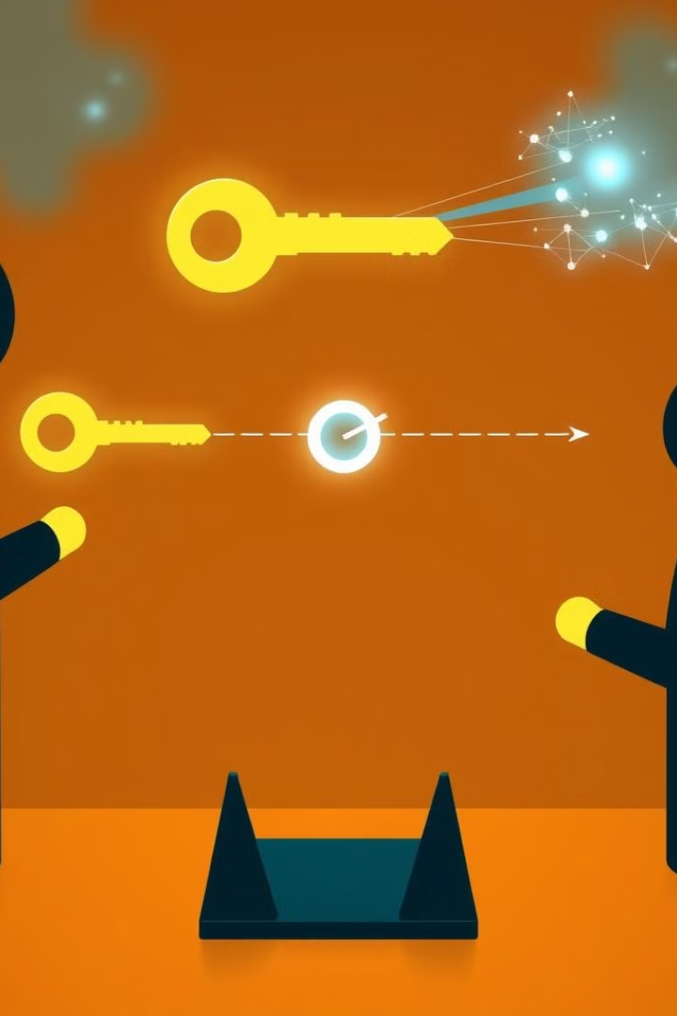
Quantum Key Distribution (QKD)
Quantum Key Distribution (QKD) is a secure communication method that uses the principles of quantum mechanics to enable two parties to generate a shared, random, secret key, which can be used to encrypt and decrypt messages. What makes QKD special is that it ensures the security of the key exchange process, even if an eavesdropper is trying to intercept the communication.
The most common QKD protocol is the BB84 protocol, named after its inventors Charles Bennett and Gilles Brassard (1984).

Slide 7
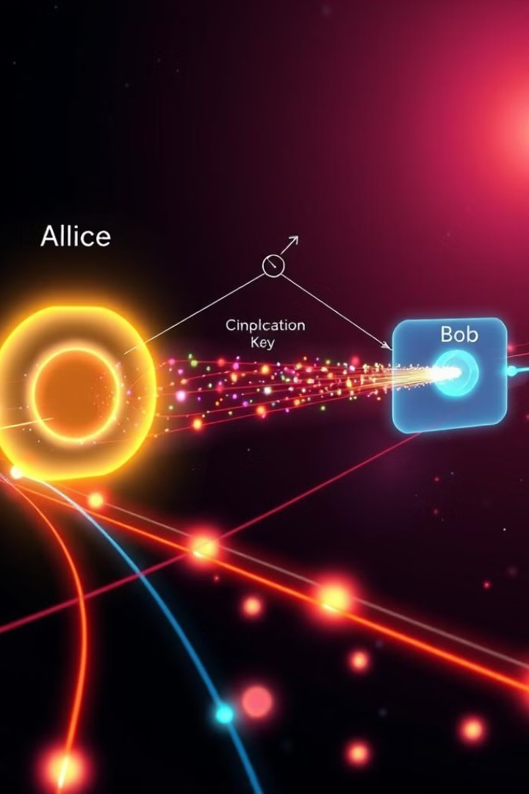
Quantum Key Distribution (QKD): Generating Shared, Secret Keys
1
Preparation of Quantum Bits (Qubits)
2
Transmission
3
Measurement
4
Public Discussion
5
Eavesdropping Detection
6
Key Generation

Slide 8
Preparation of Quantum Bits (Qubits)
Transmission
Measurement
The sender, traditionally called Alice, prepares a sequence of qubits in random quantum states and sends them over a quantum communication channel (such as an optical fiber) to the receiver, called Bob.
Bob receives these qubits and measures them using randomly chosen bases. He can choose to measure in the rectilinear basis (horizontal/vertical) or the diagonal basis (±45 degrees). The key point here is that Bob doesn’t know the polarization basis Alice used, so he guesses.
In QKD, information is transmitted using qubits, which are the quantum equivalent of classical bits. Qubits can exist in multiple states simultaneously (a property called superposition).
In the BB84 protocol, qubits are prepared in one of four possible quantum states. These states are polarized photons, and the polarization can either be horizontal, vertical, or diagonal (±45 degrees).
Due to the principles of quantum mechanics, if Bob chooses the wrong basis to measure, the qubit will collapse to a random state, and the measurement will be incorrect.

Slide 9
Public Discussion
Eavesdropping Detection
Key Generation
After the transmission, Alice and Bob publicly compare which bases they used for each qubit without revealing the actual measurements. If both used the same basis for a given qubit, the measurement is kept as part of the final key. If the bases were different, that qubit is discarded.
An essential feature of QKD is its ability to detect eavesdroppers. If a third party, traditionally called Eve, tries to intercept the communication, the laws of quantum mechanics dictate that Eve's measurement of the qubits will disturb their states. This disturbance will introduce errors that Alice and Bob can detect when they compare a small subset of their qubits.
After verifying the presence or absence of an eavesdropper, Alice and Bob are left with a set of matching qubits. They convert these into a shared secret key, which can be used with traditional encryption algorithms like the One-Time Pad (the only provably secure encryption method) for secure communication.

Slide 10


Quantum Key Exchange: The Process of Establishing a Shared Key
Alice (1010)
Bob
1 : rectileniar
1 : diagnol
0: diagnol
0: rectileniar
1 : rectileniar
1 : rectileniar
0: diagnol
0: diagnol
1010
0110

Slide 11
Quantum Cryptography Applications: From Banking to Government
Financial Security
Critical Infrastructure
Sensitive Communications
Quantum cryptography is being adopted by banks and financial institutions to safeguard sensitive transactions and data.
Governments and agencies are increasingly relying on quantum cryptography to protect essential infrastructure, such as power grids and communication networks.
Quantum cryptography is used to secure high-level government and military communications, ensuring the confidentiality of critical information.

Slide 12

Challenges and Limitations of Quantum Cryptography
1
Distance Limitations
2
Implementation Complexity
The range of quantum cryptography is currently limited due to signal loss and decoherence over long distances.
Deploying quantum cryptography requires specialized equipment and infrastructure, making it challenging to scale and integrate with existing systems.
3
Technological Maturity
4
Cost Considerations
Quantum cryptography is still a relatively new and evolving field, with ongoing research to improve its practicality and reliability.
The implementation of quantum cryptography can be costly, hindering widespread adoption, especially for smaller organizations.

Slide 13

The Future of Quantum Cryptography: Towards Unbreakable Security
1
Technological Advancements
Ongoing research and development are expected to increase the range, efficiency, and reliability of quantum cryptography systems.
2
Widespread Adoption
As the technology matures, quantum cryptography is poised to become a standard for securing critical communications and data in a wide range of industries.
3
Unbreakable Encryption
The fundamental principles of quantum mechanics will enable quantum cryptography to provide a level of security that is theoretically unbreakable, even by the most powerful future computers.

